Slide 1
Lending Club Case Study
Upgrad lending club case study project

Slide 2
Table of Contents
The Problem
Domain, Context and Problem Statement
Decision Matrix
Dataset understanding
Assumptions
Challenges deep dive
Approach
Key Columns
Excluded Columns
Data preprocessing
Analysis (Univariate, Bivariate, Multivariate)
Inferences
Result
Recommendations
Team

Slide 3
The problem
Company
Context
Problem statement
There is a lending company which is the largest online loan marketplace, facilitating personal loans, business loans, and financing of medical procedures. Borrowers can easily access lower interest rate loans through a fast online interface.
Lending loans to ‘risky’ applicants is the largest source of financial loss (called credit loss). Credit loss is the amount of money lost by the lender when the borrower refuses to pay or runs away with the money owed. In other words, borrowers who default cause the largest amount of loss to the lenders. In this case, the customers labelled as 'charged-off' are the 'defaulters'.
Company wants to understand the driving factors (or driver variables) behind loan default, i.e. the variables which are strong indicators of default. The company can utilise this knowledge for its portfolio and risk assessment.
Main objective is to find variables in the dataset which influences for loan to be defaulted.

Slide 4
The problem
Context
The lending company faces largest amount of financial loss due to loan defaults. The amount lost by the lender when a borrower defaults is called credit loss. A loan is called to be defaulted when borrower does not return the amount fully/partially. These loans are also called to be Charged Off. Borrowers can easily access lower interest rate loans through a fast online interface. Company approves loan based on its current risk assesment of tendency of the loan getting default.
Company wants to reduce the loss due to loan defaults by rejecting loans which are likely to be default. However risk associated with this rejection decision is to lose a loan which otherwise would have been fully paid. Company is looking improve their ability to more accurately understand the lieklyhood of a loan application getting default if approved.
Problem statement
The company has provided few years of data which consists of various attributes of loans which where approved and are etiher fully paid or charged off (defaulted) or is currently running.
We need to understand the influences of loan and consumer atributes towards tendency to default and indentify variables which are strong indicators of default.
The company can utilise this knowledge for its risk assessment to reduce the loss.

Slide 5
Decision Matrix
Loan Accepted - Three Scenarios
Fully Paid - Applicant has fully paid the loan (the principal and the interest rate)
Current - Applicant is in the process of paying the instalments, i.e. the tenure of the loan is not yet completed. These candidates are not labelled as ‘defaulted’.
Charged-off - Applicant has not paid the installments in due time for a long period of time, i.e. he/she has defaulted on the loan
Loan Rejected - The company had rejected the loan (because the candidate does not meet their requirements etc.).
Since the loan was rejected, there is no transactional history of those applicants with the company and so this data is not available with the company (and thus in this dataset).

Slide 6
Dataset Understanding
Dataset given contains the information about past loan applicants and whether they ‘defaulted’ or not.
Dataset contains information pertaining to the borrower’s past credit history and Lending Club loan information.
Dataset consisted of over 39717 records and 111 columns along with Data dictionary contains information about each column and their relevance.
Dataset reflects loans post approval, thus does not represent any information on the rejection criteria process.
Dataset has column `loan_status` which shows information such as:
Fully-Paid - The customer has successfully paid the loan
Charged-Off - The customer is “Charged-Off” ir has “Defaulted”
Current - These customers, the loan is currently in progress

Slide 7
Assumptions
loan_status is “Current” is not useful.
Binning with uniform intervals
Monotonous column, ids (such as id, member_id) columns are not useful.
Free form columns like description , title are not influensive to result.
Atributes created after loan approval are not considered for analysis

Slide 8
Challenges deep-dive
Challenge 1
Challenge 2
Challenge 3
Find relevant attributes
To find columns which are really significant for analysis and contribute to discover patterns.
Data Correction
Some of the columns has missing values and data is not in the correct format so data cleansing and standardization is needed. Neatly segregation of categorical and numerical columns.
Discover Relations in attributes
Once data will be in correct format then on remaining columns we need to do analysis and find patterns which affects `loan_status` variable with respect to other variables by using EDA (Univariate, Bivariate, Multivariate) Analysis.

Slide 9
Approach

Slide 10
Stages
Analysis of the dataset
Univariate
Segmented Univariate
Bivariate
Multivariate analysis
Drop Null Columns
Drop Current loan_status
Handle Missing
Data Cleaning
Standardization
Analysis
Results
Standarized Column values:
Percentage
Date
Parsing Dates where years going back to 1946.
Conclusions,Inferences and Recommendations

Slide 11
Key Column Selection
Customer Demographics
Annual Income (annual_inc)
Home Ownership (home_ownership)
Employment Length (emp_length)
Debt to Income (dti)
State (addr_state)
Loan Attributes
Loan Amount (loan_amt)
Grade (grade)
Term (term)
Loan Date (issue_date)
Purpose of Loan (purpose)
Verification Status (verification_status)
Interest Rate (int_rate)
Installment (installment)
Public Records (public_rec)
Public Records Bankruptcy (public_rec_bankruptcy)
Derived Attributes
Range bins for selected continuous data types
Year and Month columns for selected date types.
- Selected above column based on the market research indicating their influences on loan default.

Slide 12
Exclusion Made
Columns
Columns containing NA values only
Columns containing single unique value
Non business columns like ids, title, desc, url
Rows
“Current” loan_status
Rows for low caridnality dimensions
Rows corresponding to outliers for various continous attributes.

Slide 13
Selection of Analysis Type
Frequency bar plot for categorial data
Summary analysis of continuous data
Scatter Plot between two continuous data type
Bar Plot for analysis for a categorial data segmented by loan_status
Bar Plot for Bivariate Analysis between categorial data
Box Plot for bivariate or segmented univariate with continuous data
Heatmap for multivariate analysis

Slide 14
Key Columns
Loan Attributes
Loan Amount (loan_amt) : Represents the amount of money requested by the borrower as a loan
Grade (grade) : Represents a rating assigned to the borrower based on their creditworthiness, indicating the level of risk associated with the loan.
Term (term) : Duration of the loan, typically expressed in months.
Loan Date (issue_date) : Date when the loan was issued or approved by the lender.
Purpose of Loan (purpose) : Indicates the reason for which the borrower is seeking the loan, such as debt consolidation, home improvement, or other purposes.
Verification Status (verification_status) ): Represents whether the borrower's income and other information have been verified by the lender.
Interest Rate (int_rate) ): Represents the annual rate at which the borrower will be charged interest on the loan amount.
Installment (installment) : Represents the regular monthly payment the borrower needs to make to repay the loan, including both principal and interest.
Public Records (public_rec) : Derogatory Public Records. The value adds to the risk to the loan. Higher the value, lower the success rate.
Public Records Bankruptcy (public_rec_bankruptcy) :Number of bankruptcy records publicly available for the customer. Higher the value, lower is the success rate.

Slide 15
Excluded Columns
Customer Behaviour Columns - Columns which describes customer behaviour will not contribute to the analysis. These attributes are not significant for consideration towards the loan approval/rejection process.
Granular Data - Columns which describe details which are very specific to company, may not be required for the analysis. For example, “grade” column may be relevant for creating business outcomes but “sub grade” is be very granular and will not be used in the analysis.
54 columns contain NA values only, and these columns will be removed namely: acc_open_past_24mths, all_util, annual_inc_joint, avg_cur_bal, bc_open_to_buy, bc_util, dti_joint, il_util, inq_fi, inq_last_12m, max_bal_bc, mo_sin_old_il_acct, mo_sin_old_rev_tl_op, mo_sin_rcnt_rev_tl_op, mo_sin_rcnt_tl, mort_acc, mths_since_last_major_derog, mths_since_rcnt_il, mths_since_recent_bc, mths_since_recent_bc_dlq, mths_since_recent_inq, mths_since_recent_revol_delinq, num_accts_ever_120_pd, num_actv_bc_tl, num_actv_rev_tl, num_bc_sats, num_bc_tl, num_il_tl, num_op_rev_tl, num_rev_accts, num_rev_tl_bal_gt_0, num_sats, num_tl_120dpd_2m, num_tl_30dpd, num_tl_90g_dpd_24m, num_tl_op_past_12m, open_acc_6m, open_il_12m, open_il_24m, open_il_6m, open_rv_12m, open_rv_24m, pct_tl_nvr_dlq, percent_bc_gt_75, tot_coll_amt, tot_cur_bal, tot_hi_cred_lim, total_bal_ex_mort, total_bal_il, total_bc_limit, total_cu_tl, total_il_high_credit_limit, total_rev_hi_lim, verification_status_joint
Other irrelevant columns such as id, member_id, emp_title, desc, title, url which does not contribute to the analysis will be dropped as well.

Slide 16
Data Cleaning & Pre-processing
While loading the dataset, some of the variables had mixed data types so they have to be converted accordingly for further analysis.
There are many columns with null values. So they had to be dropped as they won’t play a role in the analysis of the dataset.
Some columns has only a single unique value so it does not make any sense to include it as part of our data analysis. 9 columns had such unique values such as ['pymnt_plan', 'initial_list_status', 'collections_12_mths_ex_med', 'policy_code', 'application_type', 'acc_now_delinq', 'chargeoff_within_12_mths', 'delinq_amnt', 'tax_liens'] and they were removed.
Dropped records where loan_status=“Current” as the loan in progress cannot provide us insights as to whether the borrower is likely to default or not.
Common functions were created for repeating common operations like plotting bar graphs, box plots, histograms, count plots, binning etc.
Converted columns like debt to income (dti), funded amount (funded_amnt), funded amount investor (funded_amnt_inv), interest rate (int_rate) and loan amount (loan_amnt) to float to match the data. Also converted loan date (issue_d) to DateTime (format: yyyy-mm-dd).

Slide 17
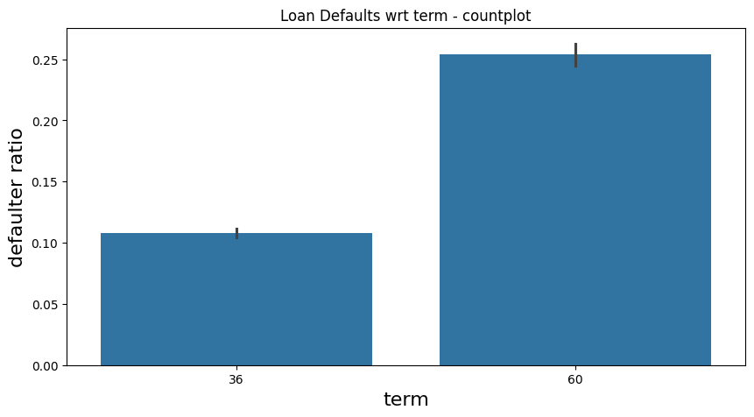
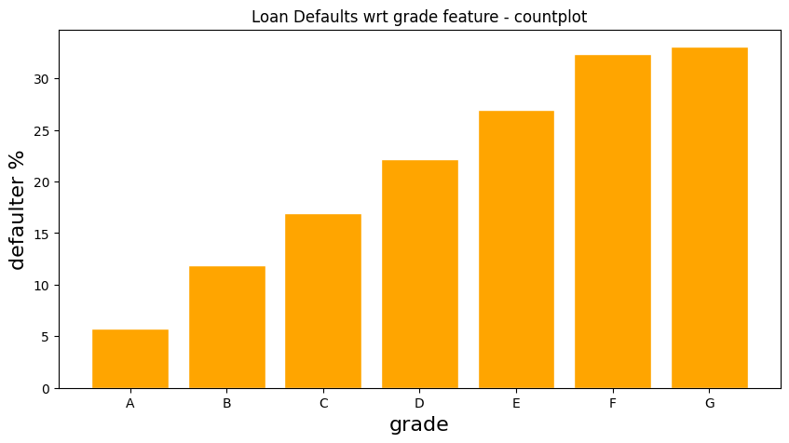
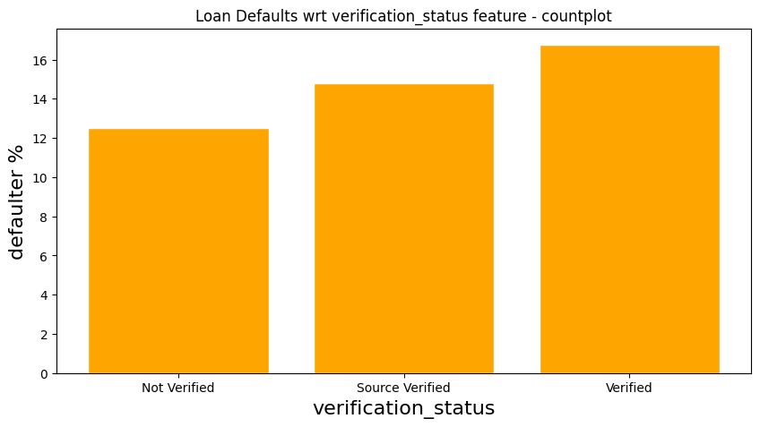
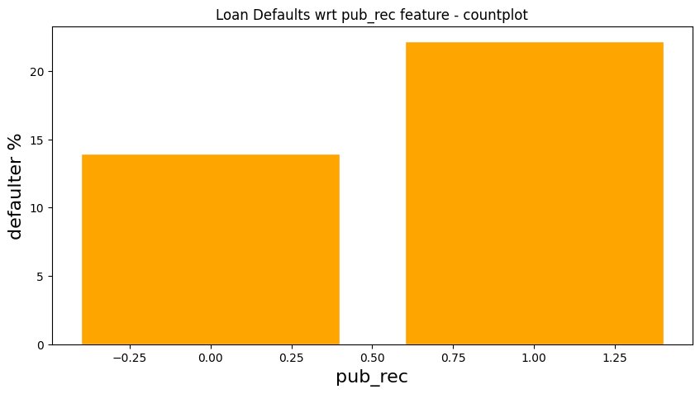
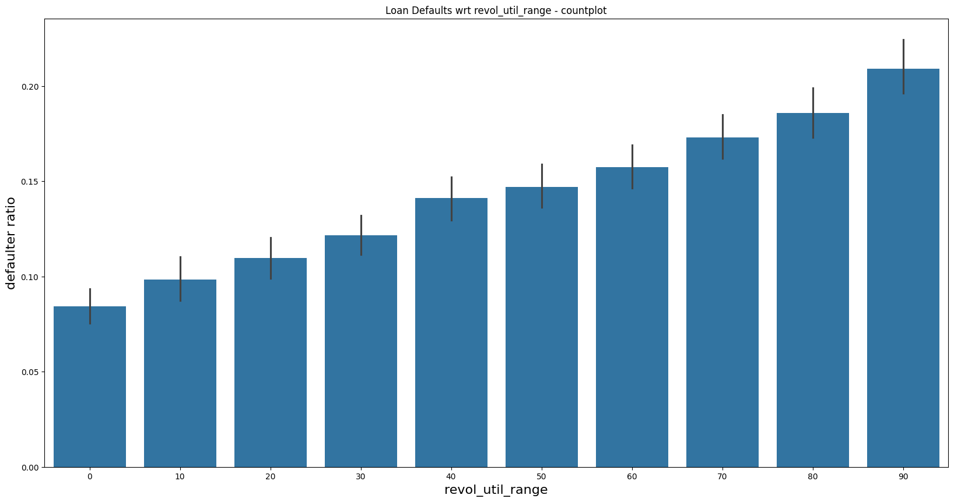
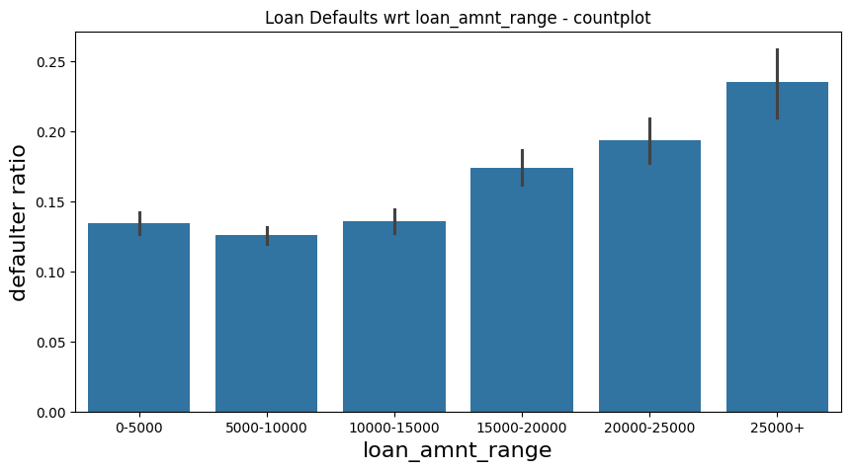
Univariate Analysis

Slide 18
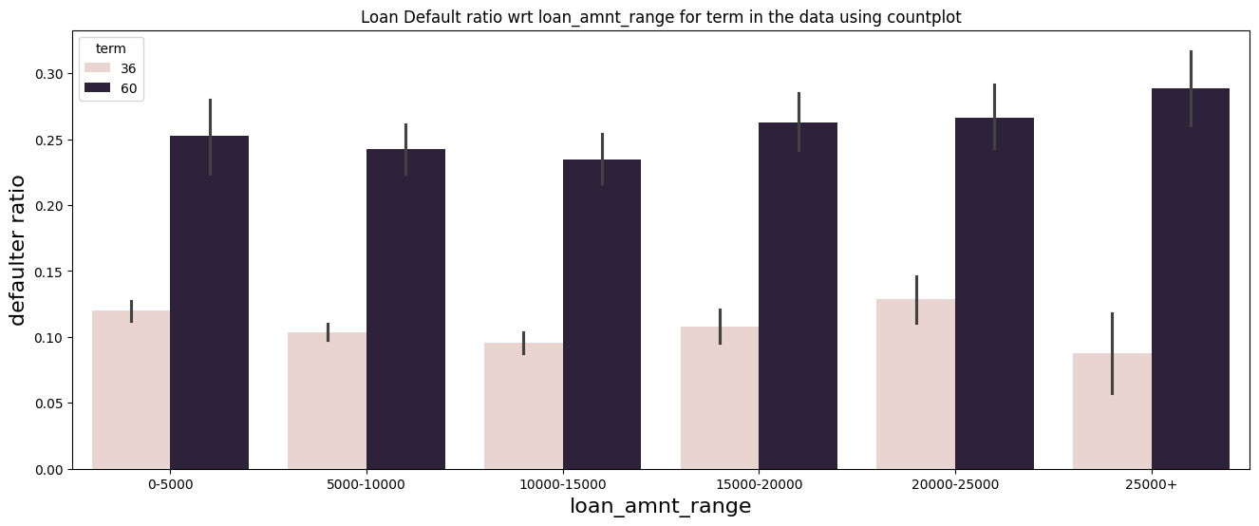
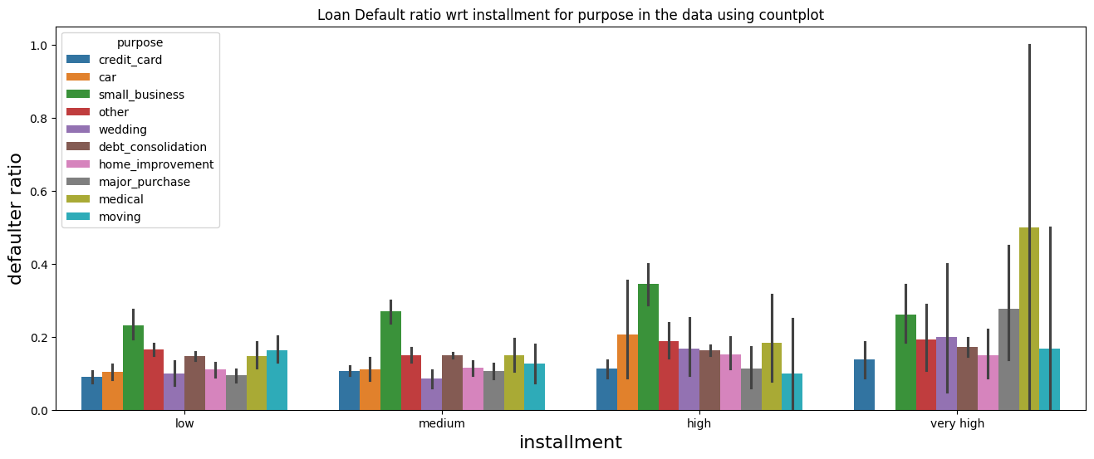
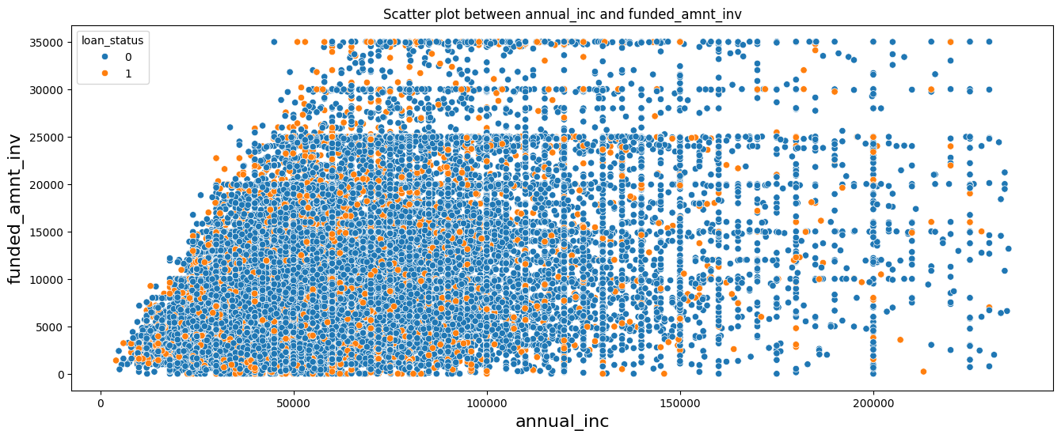
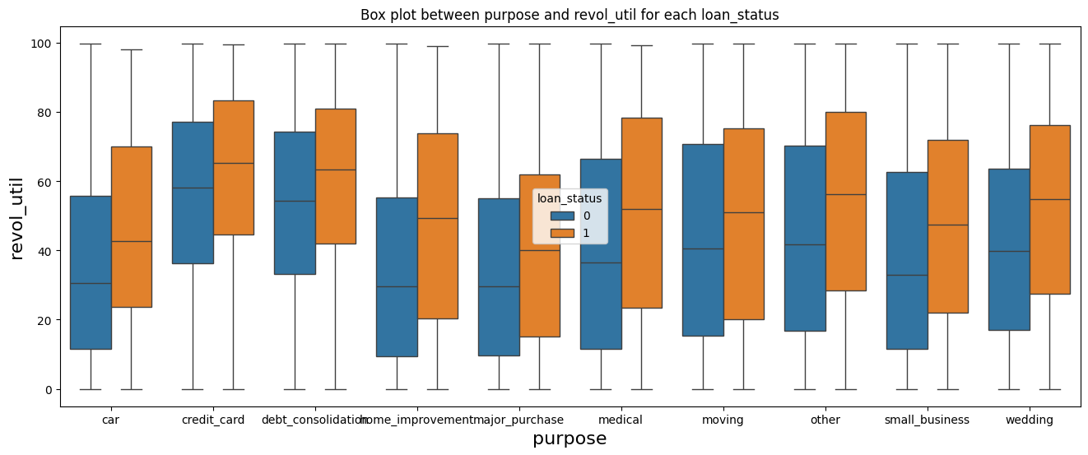
Bivariate Analysis

Slide 19
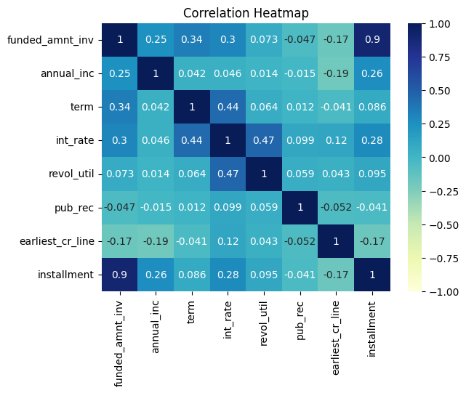
Multivariate Analysis

Slide 20
Inferences
Univariate Analysis
Defaulter rate is increasing with respect to term, grade, sub_grade, verification_status, pub_rec, pub_rec_bankruptcies, revol_util, loan_amnt, int_rate, installment.
Defaulter rate is decreasing with annual_inc.
We have seen that grade D, E, F, G has ~23% total loan however chances of being defaulted is also high here and cover 40% of total defaulters. Hence it makes sense to reject loans for borrowers in these three categories. Hence `grade` can become a deciding variable for loan approval.
Small_business has higher defaulter rate among other purposes.
Bivariate Analysis
medical purpose has highest tendency to default with installments > 800.
Multivariate Analysis
There is no stronger correlation with columns which greatly affects loan_status.

Slide 21
Result
As per dataset analysis, below variables can be driving factors for loan approval process
Term
Grade
Purpose
Revolving line utilization rate (revol_util)
Interest rate
Installment
Annual income
Public Record
Public Record for bankruptcies
Funded amount by investors

Slide 22
Recommendations
As per dataset analysis, below points might be considered for loan approval process
tendency to default is very high with borrowers having 2 bankruptcies.
Implement Stricter Criteria for Grades E, F and G, they increase tendecy to default.
Evaluate and Limit 60-Month Loans
Review Verification Process as from dataset it is observed that verified loans are more defaulted which should be otherwise.
Adjust Interest Rates Based on DTI Ratios
Consider Annual Income Levels for Affordability

Slide 23
Team
Raman Pandey
Rajeev Ranjan

